Slide 1

Haiti fEMR
Progress, Requirements, and Iteration Plan

Slide 2
Progress
Finished Iteration 2 and started Iteration 3
Iteration 3 originally was functional navigation bar
Currently:
Viewable Triage, Medical, Pharmacy page
Functional Admin page

Slide 3
Moving To Iteration 3(9/23-9/29)
Goals:
Kevin: Set up a mock laptop for an Ad-Hoc network, work on (finish?) Triage functionality
Steve: Finish Navigation, implement Form Validation, and contact a designer, work on (finish?) Medical functionality
David P: Continue working on the pharmacy page, learn javascript
David W: Documentation

Slide 4
Iteration 4 (9/30-10/06)
Goals:
Have an Ad-Hoc network running
Completed Pharmacy/Medical/Triage Page
Completed SQL scripts for database

Slide 5
Iteration Plan – Feature Overview
Week | Sunday Meeting Milestones - Features | Date
1 | Login Screen | 15-Sep
2 | triage/medical/pharmacy page look and feel | 22-Sep
3 | fully functional site navigation, unit tests, form validation | 29-Sep
4 | fully functional admin section, Ad Hoc Network | 6-Oct
5 | fully functional triage/medical page | 13-Oct
6 | fully functional pharmacy page | 20-Oct
7 | Extras | 27-Oct
8 | Beta Release and Extras | 3-Nov
9 | Extras | 10-Nov
10 | Release Candidate & Extras(?) | 17-Nov
11 | Release | 24-Nov

Slide 6
Requirements – General
ALL interactions with the patient tracked
Physician changes vitals? Record old and new
What nurse did the patient see? What doctor did the patient see? etc
Records are modifiable
Each patient gets a searchable unique ID

Slide 7
Requirements – Triage /Medical
Vitals:
Chief complaint
Blood Pressure
Heart Rate
Temperature
Respirations
Oxygen
Height
Weight
General Info:
Patient ID
First Name
Last Name
Address
City
Age
Gender
HPI:
Chief complaint
Onset
Severity
Radiation
Quality
Provokes
Physical Exam
Treatment:
Assessment
Problem List
Prescriptions
Treatment Given
Family History

Slide 8
Requirements - Pharmacy
Read medication prescribed to patients
Prescribe alternate medications (shortages)

Slide 9
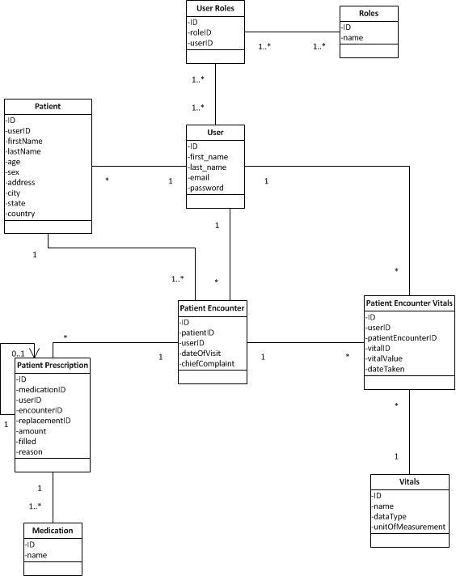

Slide 10
Architecture

Slide 11
Q&A

